Slide 1
Week 12 – Outputs / Reports
AACS2192 Analysis and Design of IS – Case Study
Library System

Slide 2
Detail Report
Reservation Report on May 2019
Content: Detail list of book reservation of the month.
User: Library Manager
Purpose: To make decision to increase the number of reservation

Slide 3
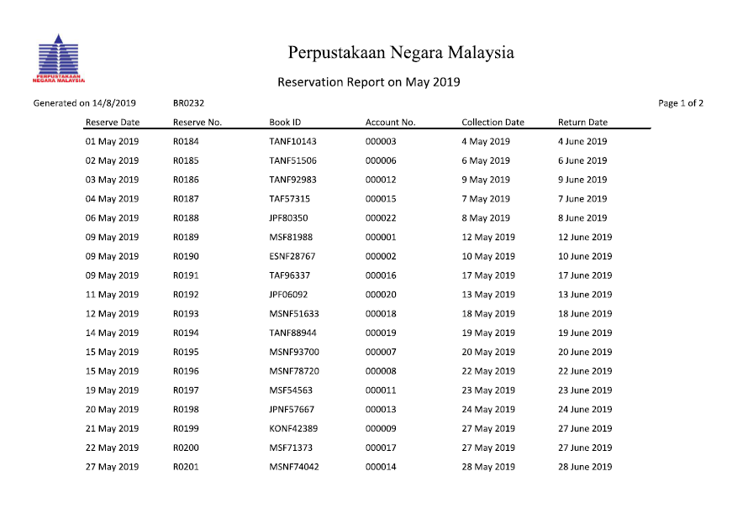
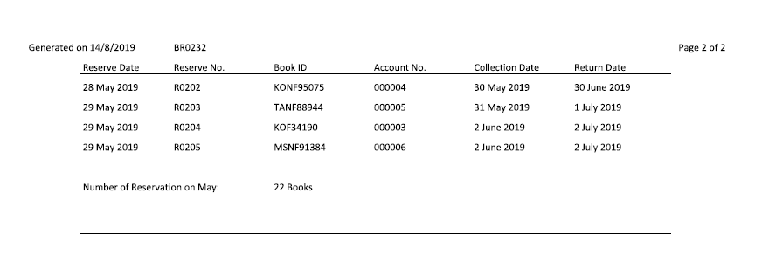

Slide 4
Exception Report
Report of Late Unpaid Fines over 7 Days for the Month Ended March, April and May 2019
Content: Number of fine paid after more than or equal to one week, for each of the months from March 2019 to May 2019
User: Library Manager
Purpose: To make decision to make more efforts to decrease the number of days before fine paid overall.

Slide 5
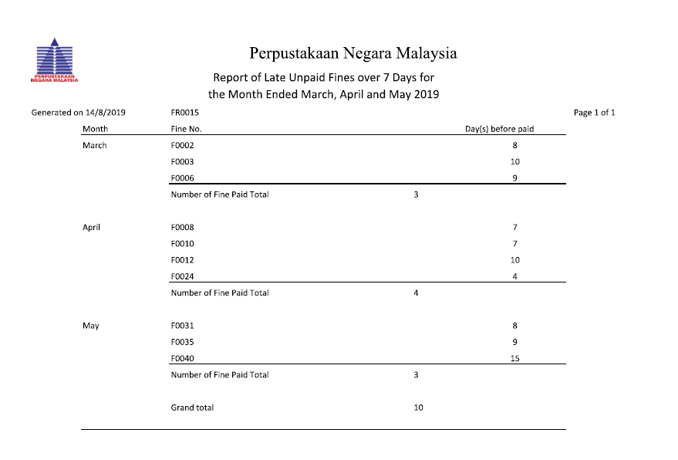

Slide 6
Summary Report
Number of books reserved by each language on Feb 2019
Content: Number of books reserved by each language on Feb 2019.
User: Librarian
Purpose: To make sure the number of books can be reserved is adequate

Slide 7
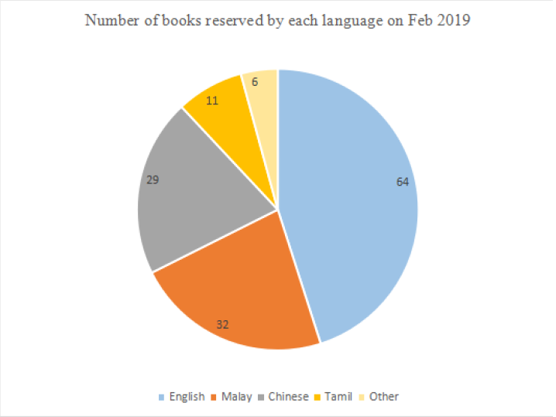

Slide 8
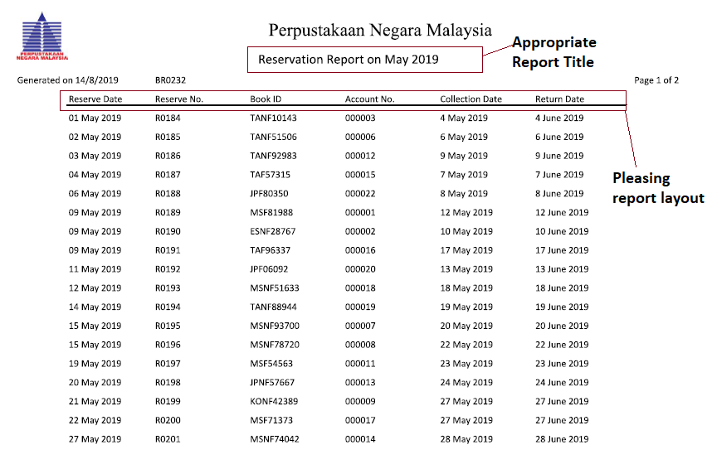
Principle of Good Report Design

Slide 9
Appropriate report title (Name) A suitable name has to be provided to each report according to the nature of contents. It should also highlight upon its origin and the person for whom it is being prepared.
Pleasing report layout (Lable) All the data has been labelled clearly.
Meaningful report content Relevant accurate data is alone included in the report. If not so, it will involve unnecessary expenditure and the reports will be a waste.
Ending Line A report contains information which will tell the users when he or she has come the end of the document or a display screen.

Slide 10
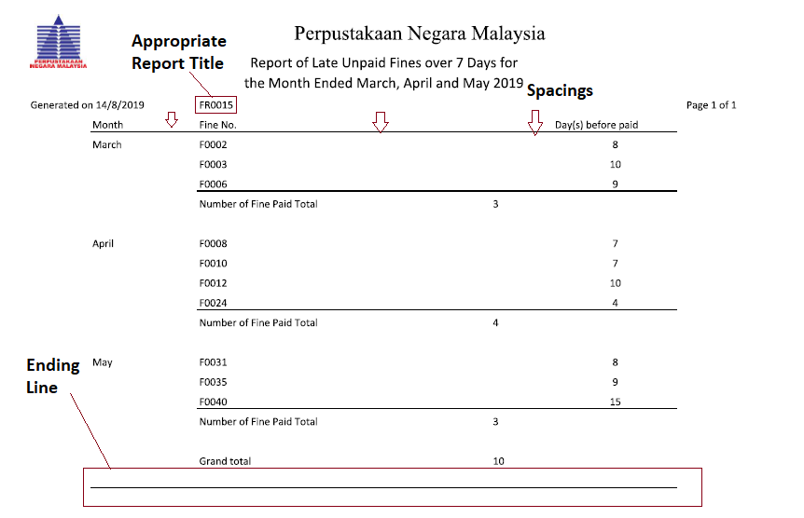
Principle of Good Report Design

Slide 11
Appropriate report title (Revision) Where the same report has been produced more than one time, indicate the data of printing and version number.
Pleasing report layout (Spacing) The data in the table cannot be too concentrated need to have appropriate spacing and well layout on paper.
Meaningful report content (Accuracy) Research report must be prepared carefully. It must be free from calculate mistakes.
Ending Line A report contains information which will tell the users when he or she has come the end of the document or a display screen.

Slide 12
Principle of Good Report Design

Slide 13
Appropriate report title The length of report title is streamline and meaningful. If the title of the report is too long it will become burdensome.
Pleasing report lay out Report must be attractive in all the important regards like size, colour, paper quality. Similarly, it should use liberally the charts, diagrams, figures, illustrations, pictures, and multiple colours.
Meaningful report content Information contained in this report is represented by showing pie chart that is useful for the librarian making decision which language of books we need to buy.
Reliable Research report must be reliable. Manager can trust on it. He can be convinced to decide on the basis of research reports.

